Slide 1
Understanding Hangman: An Interactive Guessing Game

Slide 2
Agenda
Introduction to Hangman
How Hangman Works
Playing Hangman: Step by Step
The Rules of Hangman
Strategies for Winning Hangman
Hangman in Education
Innovative Uses of Hangman
Hangman and Technology
The Future of Hangman
Hangman: Beyond the Game

Slide 3
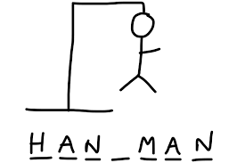
Introduction to Hangman
What is Hangman?
Hangman is a word-guessing game where players try to guess a secret word by suggesting letters one at a time.
The goal is to guess the word correctly before a complete drawing of a hanging man is displayed.
Each incorrect guess results in adding a body part to the hangman drawing.
Hangman can be played with two or more players.

Slide 4
How Hangman Works
Gameplay
Consequences
A secret word is chosen by one player.
The other player must guess the word by suggesting letters.
For each correct letter guessed, it is revealed in the word.
For each incorrect letter guessed, a part of the hangman is drawn.
The game ends when the word is guessed correctly or the hangman is fully drawn.
The player guessing the word loses if the hangman is fully drawn before the word is guessed.

Slide 5
Playing Hangman: Step by Step
The game starts with a word or phrase hidden by dashes representing each letter.
The player guesses a letter, and if it is present in the word/phrase, it is revealed in the correct position.
If the guessed letter is not in the word/phrase, a part of the hangman is drawn as a penalty.

Slide 6
The Rules of Hangman
Objective
Number of Guesses
Word Length
Guess the hidden word by suggesting letters, one at a time.
The player has a limited number of incorrect guesses before the game is over.
The length of the hidden word is provided as a hint.

Slide 7
Strategies for Winning Hangman
Start by guessing the most common letters in the English language, such as 'E', 'T', and 'A'.
Look for common letter patterns in the word, such as double letters or repeated letters.
Eliminate unlikely letters based on the letters that have already been guessed.

Slide 8
Hangman in Education
Working
Uses
Hangman is a game where players guess letters to reveal a hidden word or phrase.
Teachers can create Hangman games with subject-specific words or phrases to reinforce learning in various subjects.
Students can take turns guessing letters and learn from their mistakes as they try to solve the puzzle.
Hangman is a game where players guess letters to reveal a hidden word or phrase.
In education, Hangman can be used as a fun and interactive way to practice spelling, vocabulary, and language skills.
Teachers can create Hangman games with subject-specific words or phrases to reinforce learning in various subjects.
Students can take turns guessing letters and learn from their mistakes as they try to solve the puzzle.

Slide 9
Innovative Uses of Hangman
In Education
Hangman can be used as a fun and interactive way for students to learn new vocabulary.
It helps improve spelling and word recognition skills.
Teachers can create customized word lists to align with specific learning objectives.
Hangman can be integrated into online learning platforms for remote education.

Slide 10
Hangman and Technology
Introduction
Hangman is a classic word guessing game that has been adapted to be played on various technological platforms such as computers, smartphones, and tablets.
Working
The game involves one player choosing a word and the other player attempting to guess the word by suggesting letters. The technology behind Hangman allows for user-friendly interfaces, interactive graphics, and real-time feedback on correct and incorrect guesses.
Uses and Future Scope
Hangman, in its digital form, serves as an entertaining and educational tool. It can be used for language learning, vocabulary building, and cognitive development. In the future, advancements in technology may introduce new features and game modes to enhance the Hangman experience.

Slide 11
The Future of Hangman
Opportunities for Innovation
Expanding Platforms
Integration with voice recognition technology for input
Incorporation of artificial intelligence to generate more challenging and diverse word choices
Multiplayer functionality for increased engagement and competition
Development of mobile applications for on-the-go gaming
Integration with social media platforms to facilitate sharing and challenges among friends
Adaptation for virtual reality (VR) and augmented reality (AR) platforms for immersive gaming experiences

Slide 12
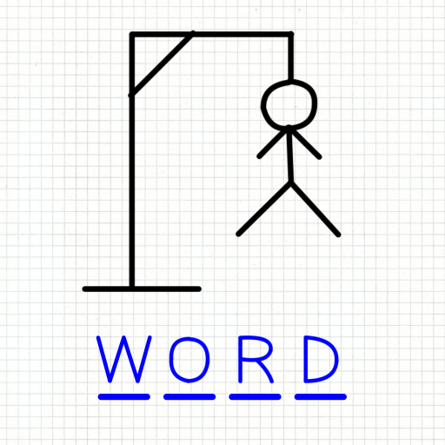
Hangman: Beyond the Game
Introduction
Hangman is a classic word-guessing game where players attempt to guess a hidden word by suggesting letters.
The game is not only entertaining but also has potential applications in various fields.
In this presentation, we will explore the working of Hangman, its uses, and its future scope.

